Slide 1
Disease Prediction on Mango Leaf Using Image Classification
Introduction to Artificial Intelligence 01
2024F-T2 BDM 3014

Slide 2
Team Members
Ajay Kumar
Armaan Verma
Dilip Bhadur Chettri
Prabhakar Thapa
Pooja Shrestha
Hargun Singh Lamba
C0942384
C0935308
C0938972
C0938310
C0938971
C0931754
Sneh Pathak
Sudip Shrestha
Shriya Upadhyay
C0938089
C0938327
C0934400

Slide 3
Table of contents
Data Gathering
01.
Industry and Domain Overview
04.
Wireframes
02.
Problem and Opportunity Statement
05.
03.
Differentiation

Slide 4

Industry and Domain Overview
Economic Importance: Mangoes are a high-value crop, particularly in tropical regions, contributing significantly to the economies of countries like India, Mexico, and Thailand.
Disease Impact: Common diseases such as anthracnose and powdery mildew can lead to yield losses of up to 50% if untreated (Source: Journal of Plant Pathology).
Research Example: Recent research in agricultural technology suggests that early disease detection can reduce crop losses by 30-40% (Source: International Journal of Agricultural Science).
1

Slide 5
Role of Image Classification in Agricultural Disease Management
Image Capture
Data Processing
Model-Based Prediction
Result Generation (Overview)
Technology Benefits
Automated disease detection can lead to faster diagnosis and reduced cost and use of harmful pesticides by guessing.
AI-based solutions are becoming popular due to their high accuracy and ability to function in diverse environments, from smartphones to industrial cameras.
2

Slide 6
Problem and Opportunity
Problem : Farmers struggle with accurate, timely diagnosis of mango leaf diseases, often relying on costly lab services or guesswork.
Studies indicate that yield losses can reach 30-50% in infected mango orchards (Source: Plant Disease Journal)
Opportunity : By providing farmers with an AI-driven solution for disease classification, this project can help reduce reliance on lab testing, minimize crop losses, and optimize pesticide use.
3

Slide 7
Target Audience and Importance
The primary users are small-scale farmers seeking affordable and accessible disease diagnosis tools.
Disease management can reduce losses, improve yield quality, and make the production process more sustainable.
Survey: A recent survey of 100 mango farmers found that 70% were willing to adopt AI-based disease detection solutions if it reduced pesticide use by 15% or more (Source: Journal of Precision Agriculture).
4

Slide 8
Differentiation
Traditional methods include manual inspection, which can be inaccurate, labor-intensive and time consuming.
Other AI-based solutions exist(Leaf Doctor) but primarily target large-scale agricultural operations or are developed for broad, multi-crop diagnostics
5

Slide 9
Why Choose Our Solution
Precision: Tailored model for mango leaf diseases, providing higher accuracy. This projects aims to simplify disease detection and enable more informed, timely actions.
User-Friendliness: Designed for non-technical users.
Economic Benefits: Reduces the need for chemical treatments, Lab expenses leading to cost savings for farmers.
6

Slide 10
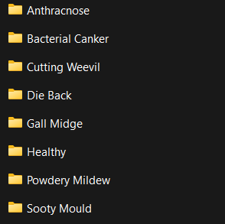
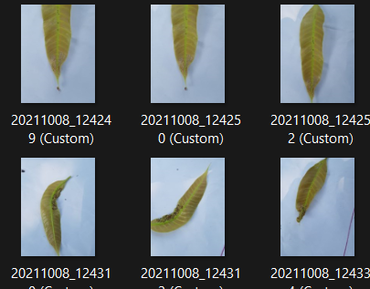
Data Gathering
Data Source: Mango Leaf Disease Dataset (Mendeley Data)
Attributes: Image, Disease Type
Progress: Complete Data Collection
Data Pre-prosessing Stage
Example of Data :
7

Slide 11
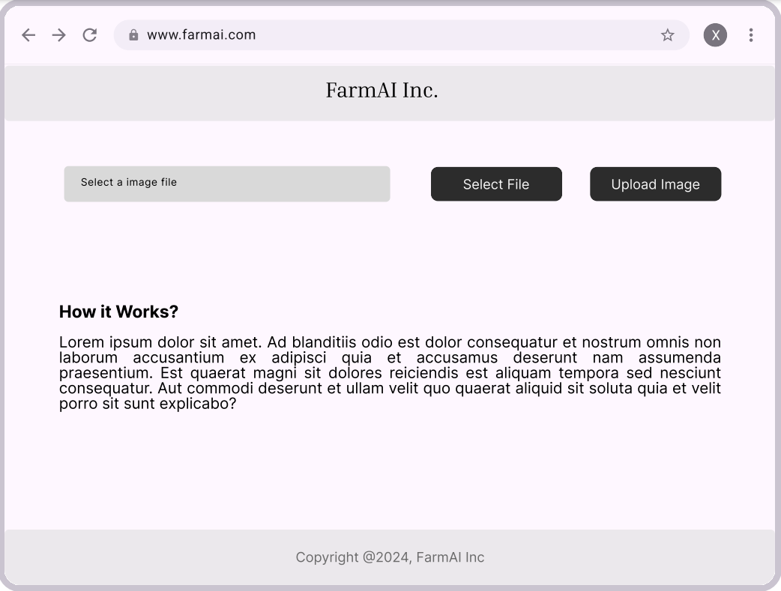
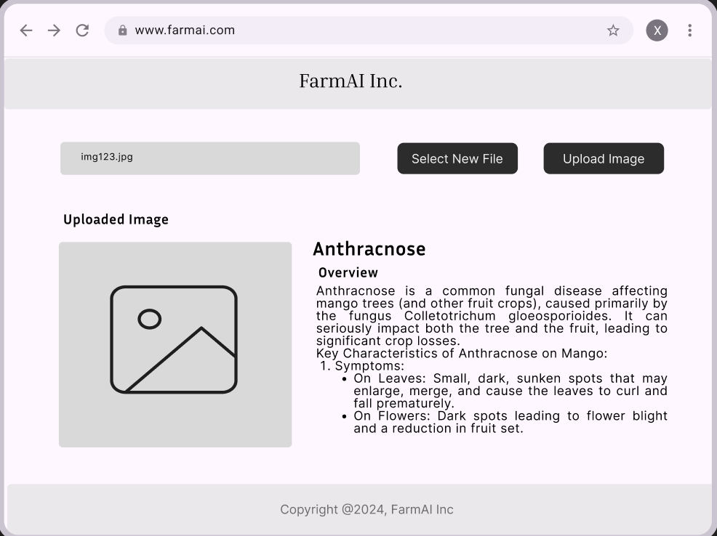
Wireframe
Home Page
Second Page
8

Slide 12
Thank you
Any Questions?

